Slide 1
Reference Based Compressed Sensing in MRI
ENGG4802 – Poster and Demonstration
Henry Hanh
43214260
Supervisor: Feng Liu

Slide 2
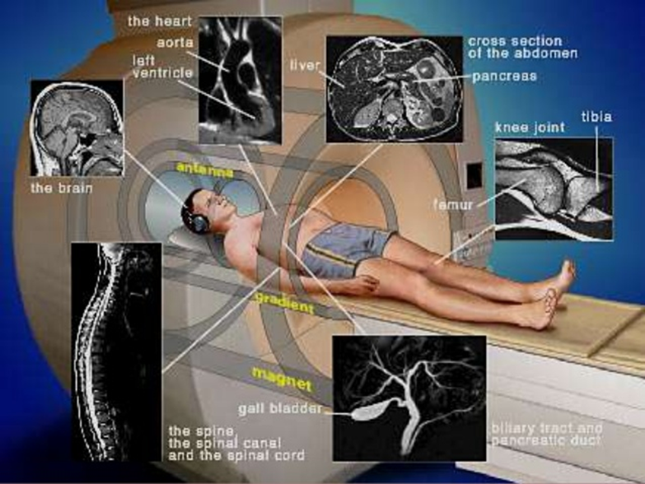
Outline
Problem Definition and Background Info
Methodology
Results
Conclusion and Future Work

Slide 3
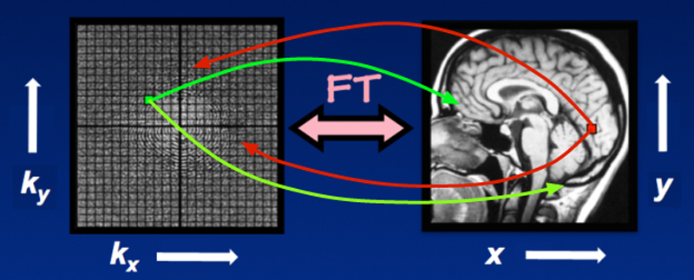
Current Challenges in MRI
Long scan times in MRI causes patient discomfort and motion artefacts
Scan speed limited by physical constraints such as maximum amplitude and slew-rate.
Conventional Cartesian Sampling in MRI
which requires long scan time
(a) Original Image (b) Image Blurring (c) Image Ghosting

Slide 4
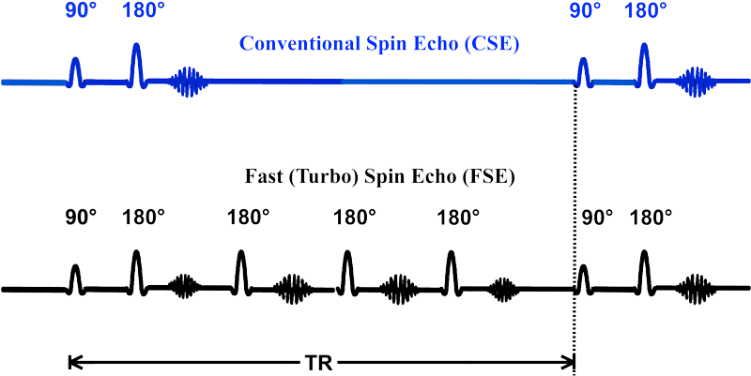
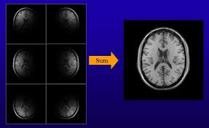
Current methods to speed up MRI
Hardware Solutions – Pulse Sequences(Rapid Imaging) and RF Coil design ( Parallel Coils)
Software Solutions - Undersampling to achieve fast imaging (Compressed Sensing)
Rapid Imaging (Fast Spin Echo) Parallel Imaging

Slide 5
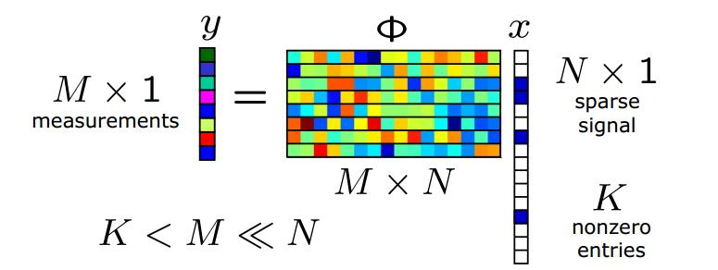
Compressed Sensing in MRI
Compressed Sensing is signal processing technique where an under sampled signal is able to be acquired and reconstructed.
CS application can be applied MRI as scan time is directly correlated to the number of samples taken.

Slide 6
Compressed Sensing fit in MRI
MRI images are sparse and compressible in some domain (Wavelet Domain and Discrete Cosine Transform)
Incoherent Sampling caused by design of Sensing Matrix (Φ) in practical sense the trajectories in MRI

Slide 7
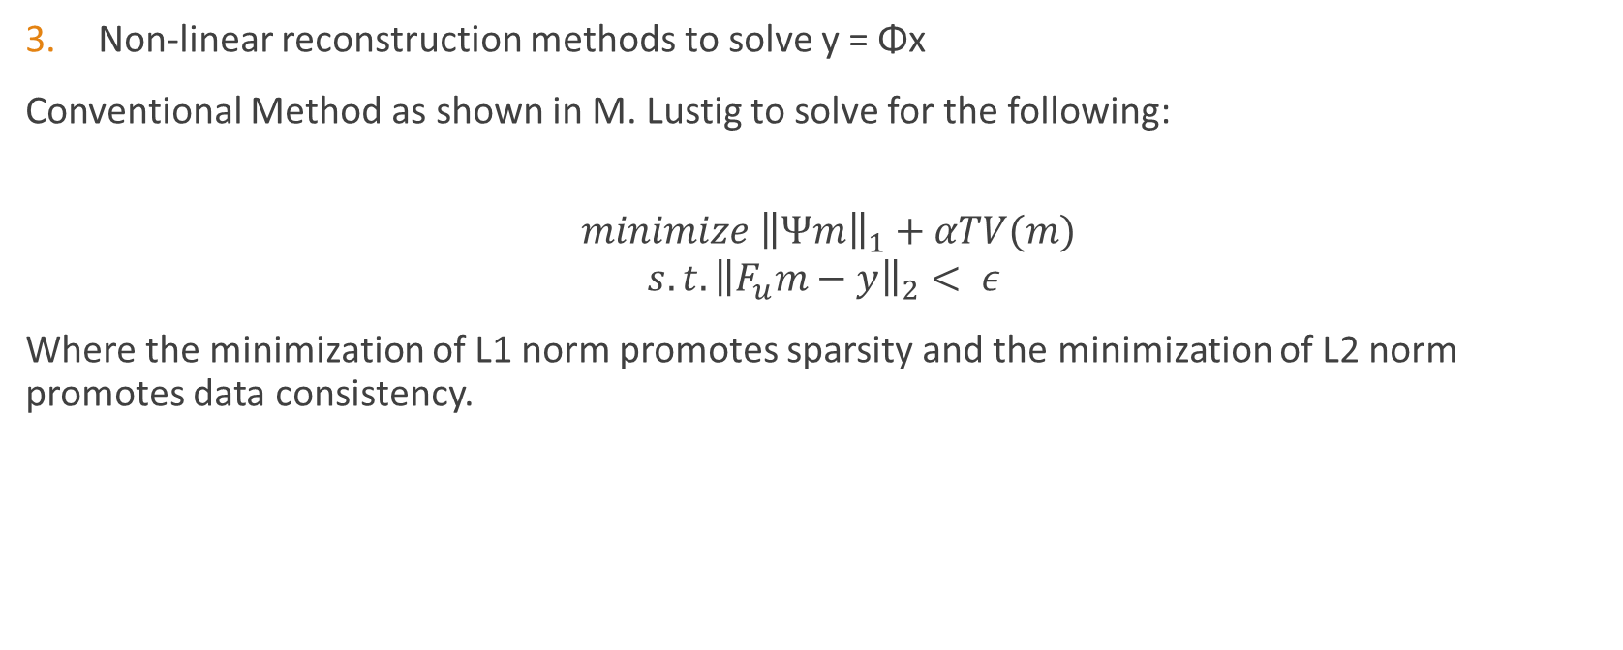
Compressed Sensing fit in MRI
Non-linear reconstruction methods to solve y = Φx
Conventional Method as shown in M. Lustig to solve for the following:
$$minimize {\left\|Ψm\right\|}_{1}+αTV(m)$$
$$s.t. {\left\|F_{u}m−y\right\|}_{2}< ε$$
Where the minimization of L1 norm promotes sparsity and the minimization of L2 norm promotes data consistency.

Slide 8
Current Disadvantages to Conventional Method
Small Ghosting and Image Blurring in non-random density sampling trajectories
Does not use previous similar previous scan to be get better image quality/ reduce scan time

Slide 9
Design Goal for thesis
Produce a better MRI image than conventional method (SPARSE-MRI) using existing image processing techniques and previous information from similar reference images.

Slide 10
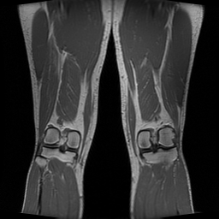
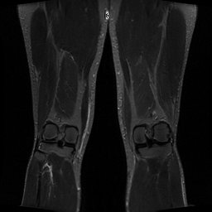
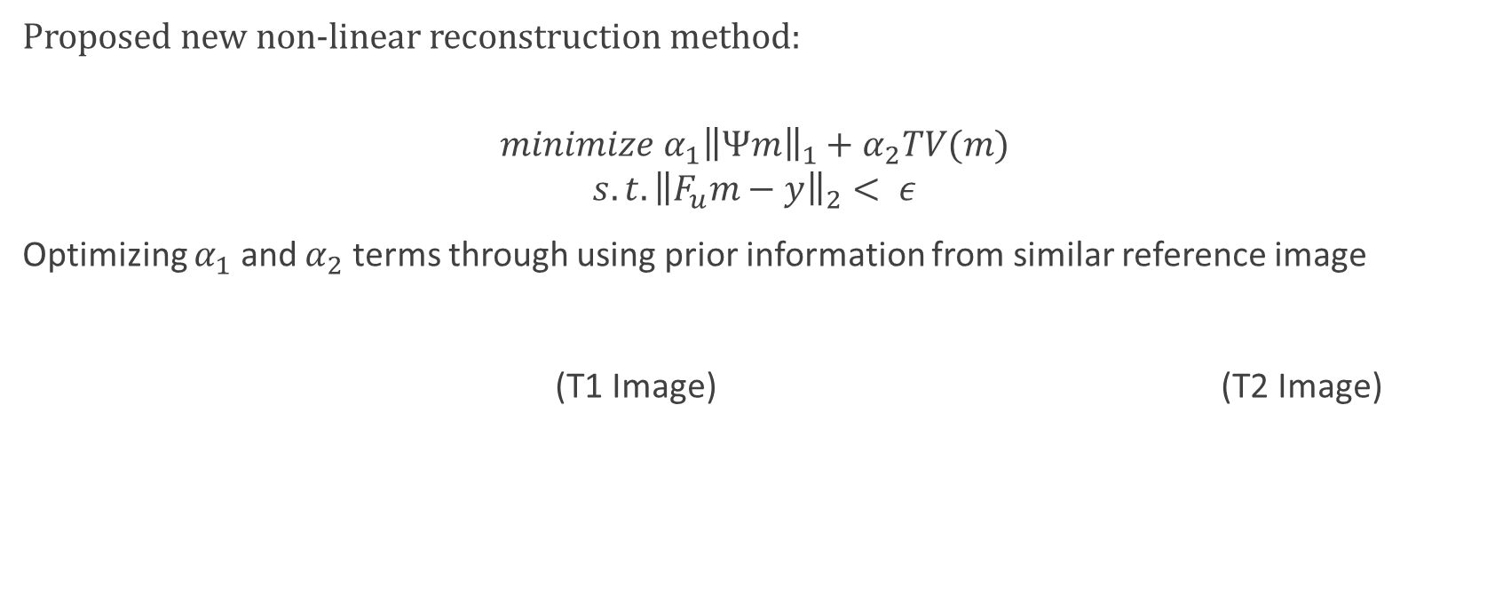
Methodology
Proposed new non-linear reconstruction method:
$$minimize {α_{1}\left\|Ψm\right\|}_{1}+α_{2}TV(m)$$
$$s.t. {\left\|F_{u}m−y\right\|}_{2}< ε$$
Optimizing $α_{1}$ and $α_{2}$ terms through using prior information from similar reference image
(T1 Image) (T2 Image)

Slide 11
Previous Information on edges using Canny Filter
Due to similar structure of similar images, can use edges as basis for reconstruction
Using Canny Filter:
Apply Gaussian filter to smooth the image in order to remove the noise
Find the intensity gradients of the image
Apply non-maximum suppression to get rid of spurious response to edge detection
Apply double threshold to determine potential edges
Track edge by hysteresis
Cleaning up

Slide 12

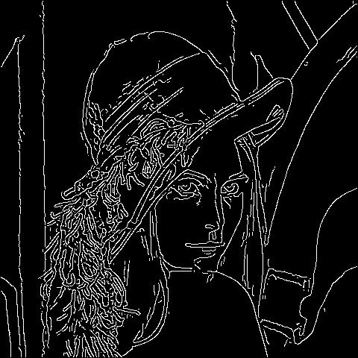
Canny Filter Results

Slide 13
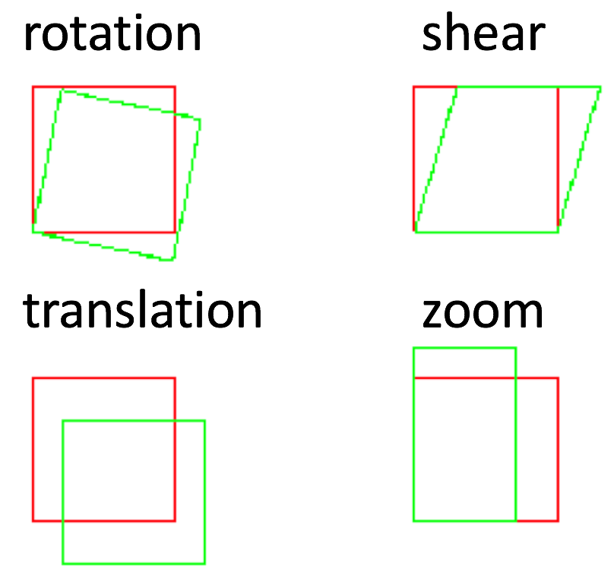
Affine Transforms
To image register/ align edge information from reference image to reconstructed image Affine transforms are used. An optimizer is used to register the reference to reconstructed.
An affine transformation is any transformation that preserves collinearity (i.e., all points lying on a line initially still lie on a line after transformation) and ratios of distances (e.g., the midpoint of a line segment remains the midpoint after transformation). This thesis uses translation, rotation, scale, and shear transformations.

Slide 14
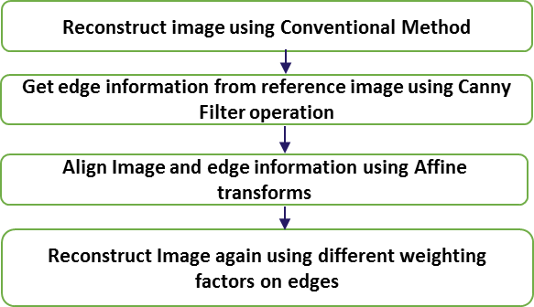
Block Diagram of Method

Slide 15
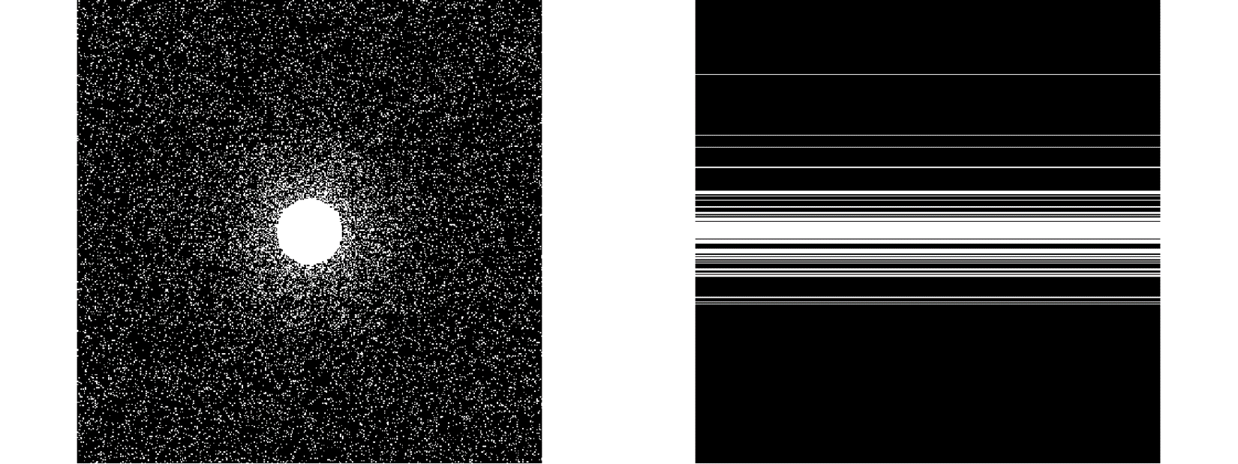
Undersampling Patterns used in results
2-D Random Undersampling Pattern 1-D Random Phase-Encode Undersampling Pattern

Slide 16
Outcome – Male Head (256x256) with Random Phase-encode Undersampling Pattern when R = 4

Slide 17
Outcome – Differences and Zoom in of Male Head (256x256) with Random Phase-encode Under sampling Pattern when R = 4

Slide 18
Outcome – Male Head (256x256) with 2D Random Undersampling Pattern when R = 4

Slide 19
Outcome – Differences and Zoom in of Male Head (256x256) with 2D Random Undersampling Pattern when R = 4

Slide 20
Conclusion and Future Work
Maximization of L1 weightings and minimization TV weightings(~0) on edge produce the best reconstructed image.
Minimization of TV and L1 on non-edge components produce
Proposed method provides an improvement of at least 4 dB in PSNR and 0.15 in SSIM value.
Proposed method reduces image blurring in random phase encoding. Thus also able to implemented practically in MRI machines.
Future work to optimize the algorithm and weightings.

